Slide 1
MADWEC 3.0 - Using Renewable Energy to Power Autonomous Underwater Vehicles
Sponsor:
Daniel MacDonald
Mehdi Raessi
Advisor:
David Rancour
Team Members:
Spencer Dowty (Team Leader)
Thomas Lattanzi
Antz-Lee Francois
Arthur Grizotte

Slide 2
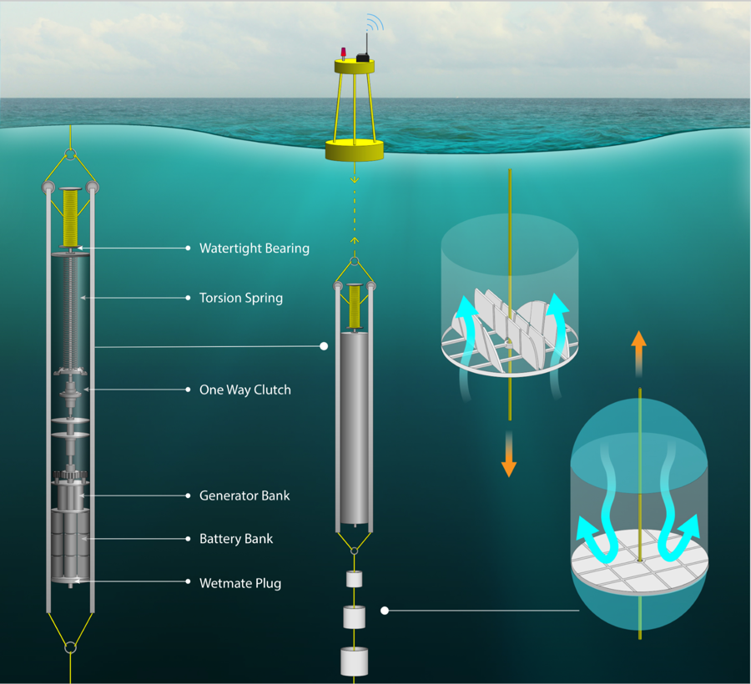
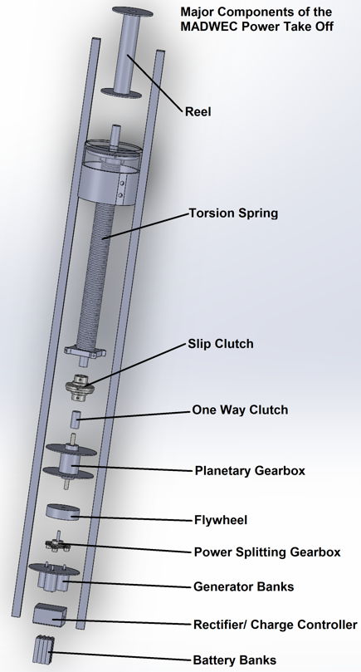
Operational View of MADWEC 3.0

Slide 3
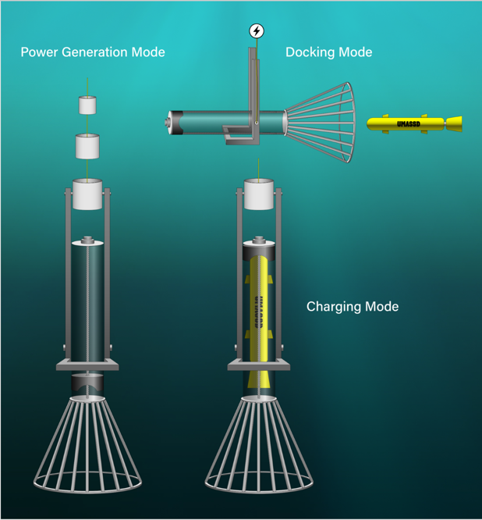
Charging Docking Station

Slide 4
Purpose
MADWEC, the Maximal Asymmetric Drag Wave Energy Converter, is designed to be a small-scale local power platform for use in remote or deep-ocean locations.
Use renewable wave energy to charge autonomous underwater vehicles (AUV’s).
Allow for a decrease in manned missions to recover AUV’s when they are low on charge.
Reduce the cost and carbon footprint of AUV missions and surveying companies.
Develop a sustainable way of running underwater missions with small autonomous vehicles.

Slide 5
Customer Requirements
1 | Design a charging station attached to the bottom of the MADWEC
2 | Autonomous underwater vehicle must dock at the station horizontally
3 | Charging should be compatible with a variety of different AUVs without requiring any alterations to the structure/hardware of the vehicle
4 | Should accommodate at least one AUV with the potential for expansion
5 | Determine a suitable battery to store the energy from the generators
6 | AC/DC converter to adapt the electrical output of the MADWEC
7 | Provide working winch to run “dry-testing” simulations in lab
8 | Accessible design and integration for MADWEC 4.0 team

Slide 6
Engineering Requirements
Customer Rqmt No. | Engineering Rqmt No. | Engineering Requirement(s) Description | Justification and / or Comments | Test Method (IADT)
1 | 1.1 | Device installation to withstand being located around 55 meters below sea level | How the charging station is interfaced with the MADWEC per sponsor request | Testing
 | 1.2 | Charging station should not interfere with power generation of the MADWEC | Maximize power stored in battery as the docking mechanism creates more drag | Analysis
2 | 2.1 | AUVs must dock at a 90 degree angle to the MADWEC system | Accommodate for MADWEC’s orientation to allow for easy docking for the AUV | Demonstration/Testing
 | 2.1 | Mechanism should fall vertically, swinging at a -90 degree angle to minimize drag | This position would alleviate the additional drag forces introduced by the dock | Demonstration/Testing
3 | 3.1 | Device Compatibility - Universal charging to power 2-3 different types of AUVs | Remus 100, Riptide UUV 7, Oceanserver IVER3, and Bluefin 9 all recommended | Demonstration/Testing
 | 3.2 | Accommodate chosen AUVs of ~9 inch diameter without requiring any alterations | To avoid any installation constraints by requesting changes to existing AUVs | Inspection

Slide 7
Engineering Requirements
Customer Requirement No. | Engineering Requirement No. | Engineering Requirement(s) Description | Justification and / or Comments | Test Method (IADT)
4 | 4.1 | Charge at least one AUV while holding true to the average charge time of 6-8 hours | Guarantee full operation of MADWEC and allow AUV to run more missions. | Analysis/Testing
5 | 5.1 | Battery with 8kWh-10kWh capacity to store power from the six 50 W generators | More efficiently charge the AUVs while simultaneously not damaging the battery | Analysis/Testing
 | 5.2 | Provide a continuous 5-10 Amps to the AUV during the charge duration | Crucial to recharging the AUV lithium batteries properly to ensure safety | Testing
6 | 6.1 | Voltage regulator in order to step down/up and stabilize the AC signal from the generators rectifying it to 32 Volts DC | Need to regulate and stabilize voltage in order to charge the battery without any damage | Testing
7 | 7.1 | Develop program to oscillate in-lab winch with 1-2 meter amplitudes and 8-15 second periods for PTO testing | Allow for more accurate data collection for output of the generators’ technical potential | Demonstration/Testing
8 | 8.1 | Utilize obtainable software and hardware that will remain accessible for at least the next 3 years (MADWEC 4.0) | Should not be obsolete within the near future since MADWEC is a long term project | Demonstration

Slide 8
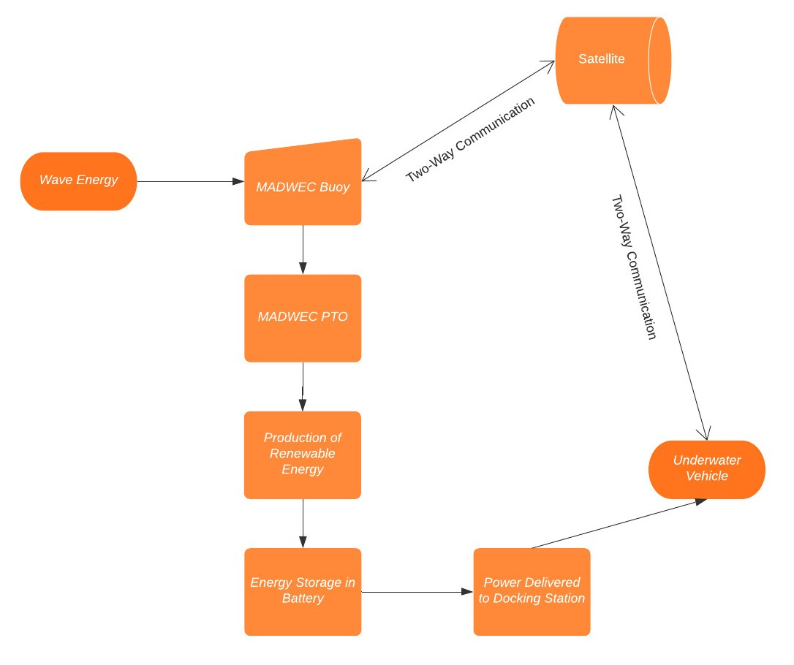
System Diagram

Slide 9
Estimated Resources
Software:
EAGLE/KiCAD - Schematic and PCB Editing
Microsoft Visual Studios - Processor Programming
MATLAB - Oscillating Winch and Analyzing Data Files
All software is already paid for by the University.
Hardware:
Components for Voltage Rectifier
Battery Bank
Step Motor/Actuator
Charging Cord for AUV
Transponder

Slide 10
Constraints
Budget: SMAST East has a stringent account that allocates the money to both the MADWEC MNE and ECE teams of around 5,000 dollars
Collaboration: Working in parallel with the Mechanical Engineers responsible for Objective 1 who have a different schedule
Time: Strict deadlines for the project conflicting with SMAST process
Limited lab space at SMAST East and UMass due to construction
Limited information on generator output due to inconsistent wave patterns from the in-lab winch and data from the previous year
Limited alterations to the current MADWEC design from the rope to the one way clutch already being established as the final product

Slide 11
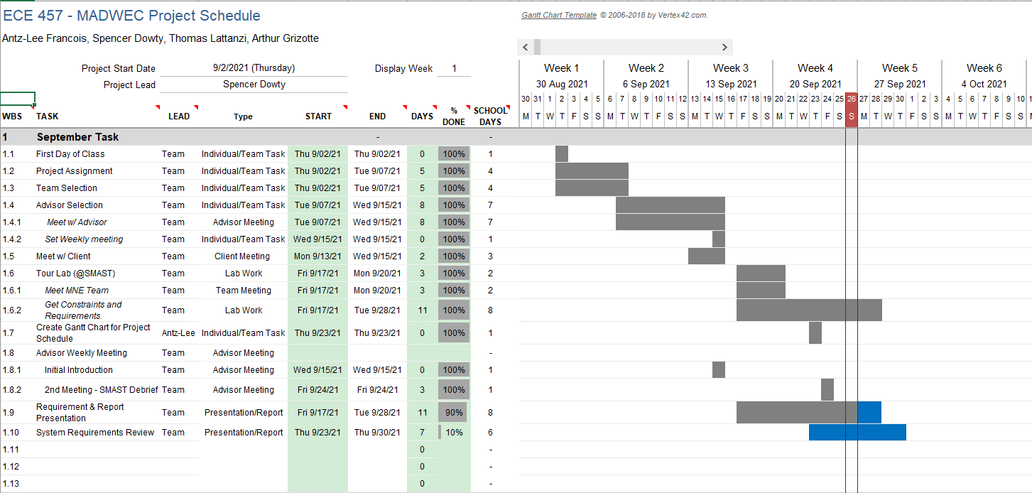
GANTT Chart - September Task List
Notes:
Gantt Chart:
Why?:
Easy to apply, easy to understand.
have one person managing the gantt chart to make sure the team is on track
Setup:
separate into 3 months ( Sept, Oct, Nov.)
within that, separate the task with a task type to keep ourselves
Advisor Meeting
Client Meeting
Team Meeting (includes MNE Team)
Lab work ( SMAST Lab in New Beford , or any lab related things)
Presentation/Report (for deadlines)
Team task and Individual Task

Slide 12
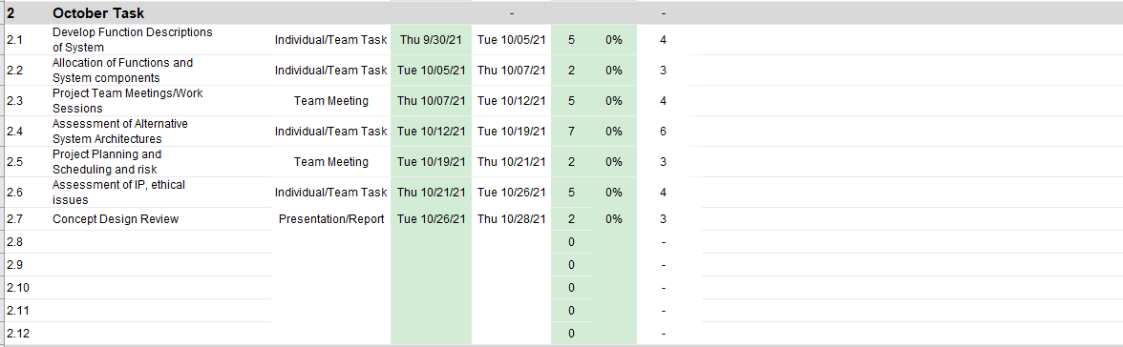
GANTT Chart - October Task List

Slide 13
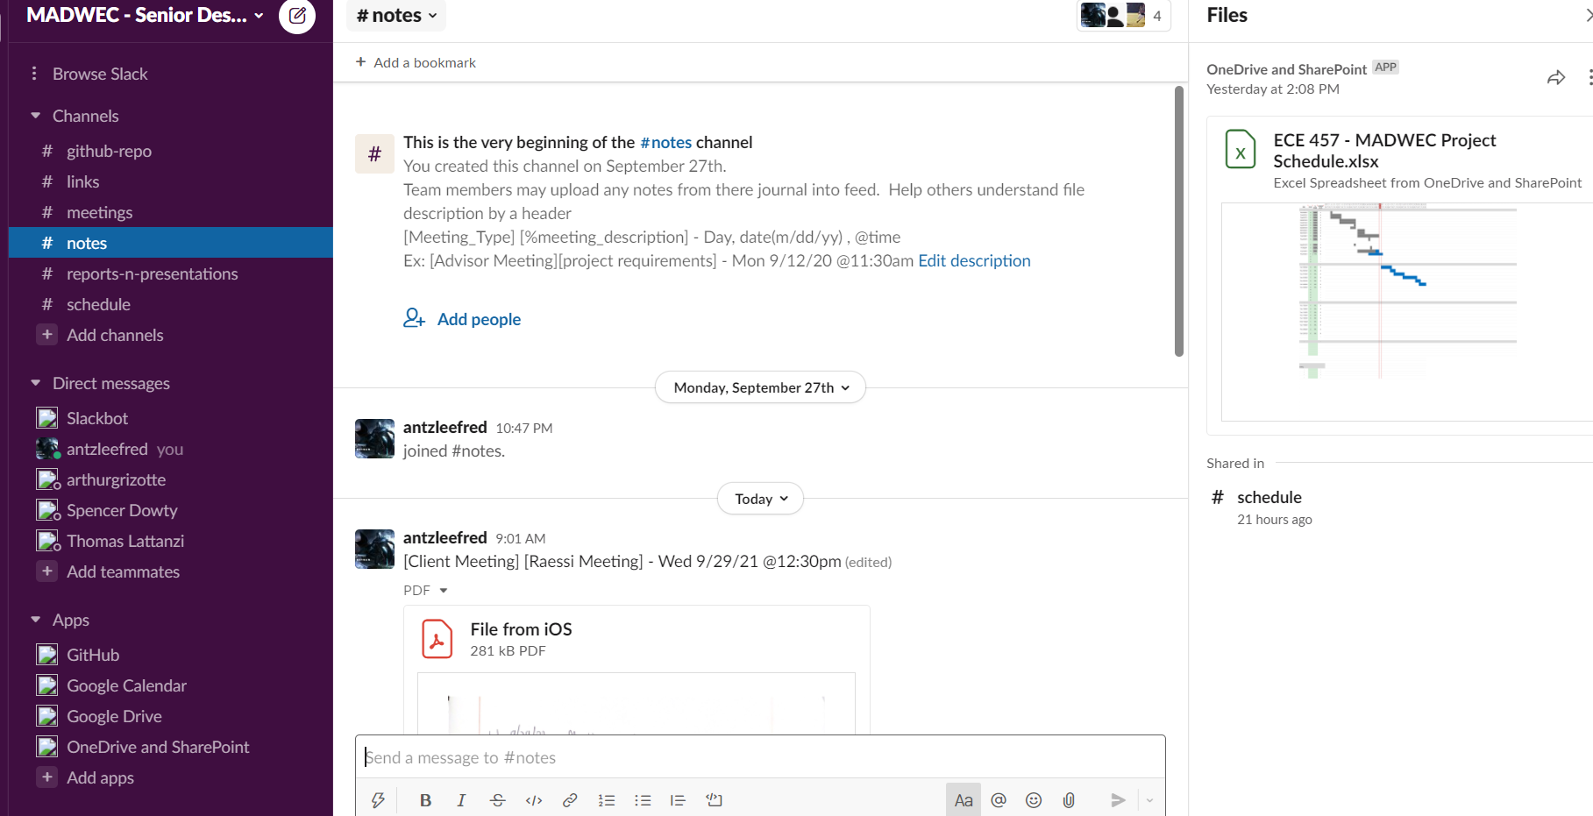
Slack - MADWEC Workspace
Notes:
Purpose:
Stay organize so we have a structure
Working on Slack Integration:
Have all of our work in one place
Creates a good communication Platform for team
Problem:
Was not a good transition between previous Team and Current
Solve:
Creates a good integration with apps like (google drive, calendar, github, one drive
Channels:
Helps keeps work organizes with update notifications
Notes, github repo, meeting updates,

Slide 14
Applicable Standards
IP Code - Waterproofing (IP67)
Institute of Printed Circuits Standards - PCB Design (IPC-2221)
Lithium Batteries - Battery Safety (IEC 62133-2:2017)
Storage of Batteries - Battery Safety (OSHA 1926.441)
RES - Renewable Energy Standard (CMR 14 + 15)
Cord Sets and Power Supply - (UL 817:Ed 11)
Electrical Testing - (BS EN 61010)
IEEE Code of Conduct & Ethics (IEEE 2, 5, 10)
Notes:
Standards that we as a team need to follow to make sure our work is approved.
IP Code Waterproofing:
Product is Water 7 dust proof
IP67 mean “ It is 100% protected against solid objects like dust and sand, and it has been tested to work for at least 30 minutes while under 15cm to 1m of water. “
PCB Design:
IPC-2221 - a generic standard for circuit board design
Battery Safety:
focuses on making sure the batteries are sealed
IEC 62133-2:2017: batteries containing alkaline or non-acid electrolytes must be sealed for use in portable applications
OSHA 1926.441: - focuses on battery location so that it there for it's exact purpose to prevent any leakage
Renewable Energy Standard:
makes sure we follow the rules for the energy standard:
purpose: make sure we provide minimum percentage in KW/hrs in sales so we dont over use the system
Power Supply:
the intended use is for non-hazardous locations
Electrical Testing:
Safety Requirements in testing the equipment .
in a control environment( lab)
Code of ethics:
2: to improve the understanding by individuals and society of the capabilities and societal implications of conventional and emerging technologies, including intelligent systems;
5: to seek, accept, and offer honest criticism of technical work, to acknowledge and correct errors, to be honest and realistic in stating claims or estimates based on available data, and to credit properly the contributions of others;
10: to support colleagues and co-workers in following this code of ethics, to strive to ensure the code is upheld, and to not retaliate against individuals reporting a violation.

Slide 15
Ethical Issues
Source of Underwater Noise
Potential Threat to Marine Animals
Accidents in the Ocean
Extreme Overcrowding
Environmental Pollution
Job Reallocation
Notes:
Be aware of the projects own Ethical Issues because of it's nature:
Environmental Concerns:
Under noise:
Not disturbing the marine life that depend on sonor and sound
Threat to Marine animals
Location in water, not a place that can harm the surrounding animals and environment
Accidents In the Ocean:
Prevent any leakage:
Battery leak/ explosion due to chemical reactions between sea water and batteries
Lubricating fluid around moving components
Solution:
Electrical components dipped in resin or create a waterproof seal
Extreme crowding and Pollution:
Have too many madwec in the ocean
Job Reallocation:
Renewable energy means less jobs for people.
since it's a cheap it's easy to buy.
somehow make sure it doesnt replace majority jobs for people.

Slide 16
References
“Applying IPC Standards to PCB Layout Design.” Cadence: PCB Design and Analysis, https://resources.pcb.cadence.com/blog/2021-applying-ipc-standards-to-pcb-layout-design
“Department of Transportation: Transportation of Lithium Batteries.” AUVAC, Department of Transportation, https://auvac.org/files/fdsys/pkg/fr-2014-08-06/pdf/2014-18146.pdf.
“Gantt Chart Template for Excel.” Vertex42, https://www.vertex42.com/ExcelTemplates/excel-gantt-chart.html.
“IP Rating Chart.” DSM&T Harsh Environment Connectors and Wire Harnessing, https://www.dsmt.com/resources/ip-rating-chart/
“Lithium-Ion Battery Standards.” USAID, International Electrotechnical Commission, https://www.usaid.gov/energy/powering-health/technical-standards/lithium-ion-batteries
“Massachusetts Renewable Energy Requirement.” Colonial power Group, https://colonialpowergroup.com/massachusetts-renewable-energy-requirement/
“REMUS 100h - Hydrographic Variant.” HII Technical Solutions, 23 Mar. 2021, https://tsd.huntingtoningalls.com/capabilities/unmanned-systems/unmanned-underwater-vehicles/remus100variants/remus100h/.
“Standards for Electrical Test Instruments and Test Leads.” Electrical Safety, https://elecsafety.com/standards-for-electrical-test-instruments-and-test-leads/
“System Diagram.” Lucid Chart: Intelligent Diagramming, https://www.lucidchart.com/pages/
“The Mysteries of IP65, IP66, and IP67 Rated Enclosures Explained.” Bud Industries, https://www.budind.com/blog/2014/02/the-mysteries-of-ip65-ip66-and-ip67-rated-enclosures-explained/
“1926.441 - Batteries and battery charging.” Occupational Safety and Health Administration,
https://www.osha.gov/laws-regs/regulations/standardnumber/1926/1926.441

